Slide 1


Farmers Access to Climate and Weather Information and its Impact on Maize and Wheat Production in Uasin Gishu County, Kenya
Daniel Murgor
University Of Eldoret, Kenya

Slide 2
Introduction
High climate variability in farming environments depresses crop productivity and constrains investment in agricultural sector.
In most sub-Saharan Africa countries Kenya included, ensuring household food security in rain fed agricultural livelihood system with the prevailing climatic variability requires availability of information on climate and weather that will reflect onset & cessation of seasonal rains

Slide 3
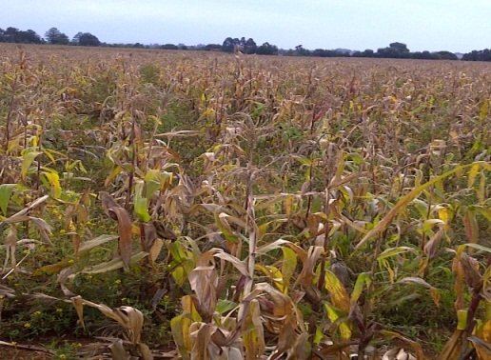
Introduction – Weather challenges
Adaptation strategies require climate information on a spatial scale that will be meaningful for planning.
Poor maize crop Megun Ward, Kesses Sub County.
Source: field data 2013

Slide 4
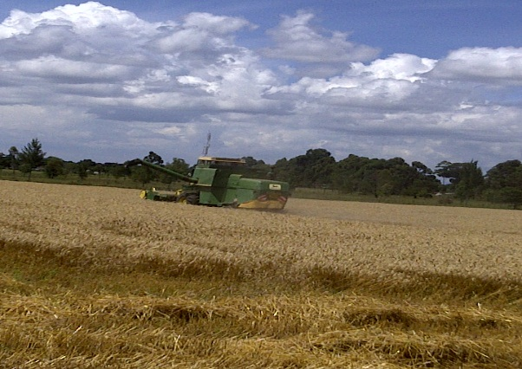
Weather challenges
Wheat harvesting with prevailing heavy rains, Mumetet Ward, Moiben
Source: Field data 2013

Slide 5
Farmers Calendar
JAN | FEB | MAR | APR | JUN | SEPT | OCT | SEPT

Slide 6
Problem Statement
The prevailing climatic variability has distorted completely timing of seasons familiar to farmers dealing with maize and wheat
Farmers rendered vulnerable and have incurred losses in their farming enterprise
Good quality climatic and agronomic data and time series of climate information is not readily available to farmers & planners in most developing countries Kenya included.

Slide 7
Problem Statement
In Uasin Gishu County, climate & weather information is not readily coordinated, shared or disseminated in a timely way.
There is also a major challenge of adaptability, format and timing challenges of climate information. ----The information is not downscaled and repackaged in formats that farmers access, understand and can use.

Slide 8
Objectives
To determine the types and sources of information on climate and weather accessible to maize and wheat farmers in Uasin Gishu County.
To examine the modes of communicating information on climate and weather to farmers.
To determine the perception of farmers towards the use of information on climate and weather and the influence of their traditional knowledge system in maize and wheat production;.
To examine the influence of information on climate and weather in maize and wheat production.
To determine acceptability of use of mobile phone technology to relay climate and weather information to farmers in the community.
To develop model to relay climate information to maize and wheat farmers in Uasin Gishu County.

Slide 9
Methodology
The study conducted in Uasin Gishu County in three sub-county areas of Moiben, Kesses and Soy selected purposively for exhibiting maize and wheat growing.
The cross sectional study adopting a mix of purposive, stratified and random sampling procedure selected 399 farmers for the interview & 12 key informants
The questionnaire was developed in line with the conceptual framework.

Slide 10
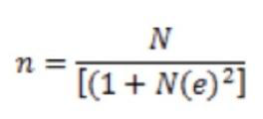
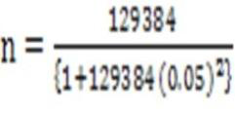
Methodology
For populations that are finite, Reid & Bore (1991) developed the equation for representative sample;
= 399
Thus, Soy= 1138/129384) *399 =189
Moiben = (38950/129384)*399= 120
Kesses = (29296/129384) *399= 90

Slide 11
Theoretical Framework
This study is guided by three theories:
the systems theory by Ludwig Von Bertalanffy 1968
The communication model also referred to as the transmission model by Shannon and Weaver 1949 and
Vulnerability adaptation framework (Ospina & Heeks, 2010).

Slide 12
Conceptual Framework
Climatic variability has distorted completely the timing of seasons familiar to farmers through experience
Indigenous knowledge systems + experience gained + climate and weather information = beneficial outcome as illustrated in the framework framework.docx

Slide 13
Key results- Perception on climate variability – rainfall changes

Slide 14
Sources of climate and weather information for farmers, its access and usage
There is low access to climate information 155 (40%) compared to 236(60%) who do not receive the information at all although KMD produces
Farmers do not largely integrate climate and weather information in their farming decisions due to Adaptability, format and timing challenges of the information

Slide 15
Access to Information
Access to information is generally farmer led agricultural shows, farmer’s field/ demonstrations are other information outlets

Slide 16
Sources of information for farmers

Slide 17
Inform… source
Indigenous knowledge systems are other sources of information that informs a farmer’s decision in the farming calendar
There is a significant relationship thus between access and usage of information (Chi = 87.263, P < 0.001). Similarly, education level is significantly related to access to climate and weather information (Chi = 17.957, P = 0.001).

Slide 18
Influence on farmer decision

Slide 19
Influence on farmer decision
Farmer’s indigenous knowledge system indicators and experience greatly influences their decision in maize and wheat growing
The use of indigenous knowledge system to plan farm activities alone have made famers incur loses as they fail to capitalize fully on beneficial weather conditions prevailing then

Slide 20
Indigenous knowledge indicators

Slide 21
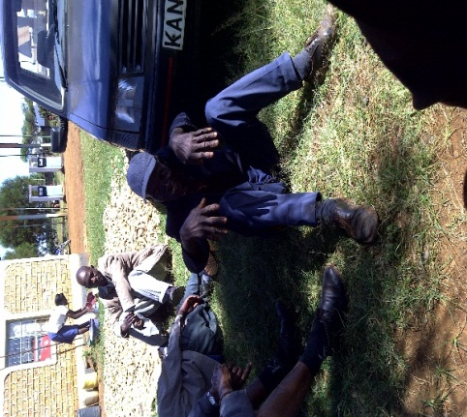
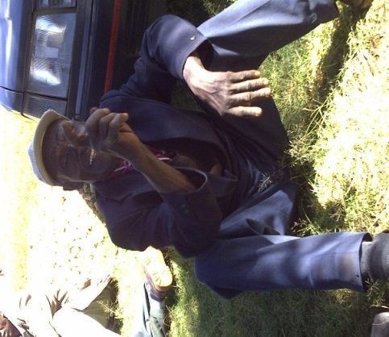
Indigenous knowledge weather forecasting
Moiben Sub-county
Source: Field data, 2013

Slide 22
Disseminating climate information - mobile phone (SMS Alerts)
While Radio and Television was cited as the most common means of receiving information on climate and weather as agreed by (79.8%) and (68.4%) farmers respectively, farmers also preferred use of mobile phone (51.4%) to receive climate updates
Delivery of agro-meteorological services that include climate information is poorly coordinated and one of the challenges is the format and media used in disseminating this information to the farmers.

Slide 23
Information Dissemination- Mobile phones
Mobile phones accessible and convenient to majority of farmers as confirmed by (92.2%)
Farmers also further stated that they use their mobile phones to receive text messages (SMS) as affirmed by 93.9%
Almost all the farmers (96.3%) preferred to receive or get updates (SMS Alerts) on climate and weather information through the mobile phone

Slide 24
Model to deliver climate information to farmers
The model developed uses SMS alerts to update farmers on climate advisories and relevant information to support farmers on farm decisions as illustrated in diagram:- model information flow.pdf

Slide 25
Conclusion and recommendation
Famers continue to rely on Agricultural extension officers and their fellow farmers for climate and weather information thus the need to empower officers with good quality climate and weather information and training
Agricultural shows, farmer’s field day/demonstrations and billboards are good outlets for climatic information to farmers and should be supported and scaled up.

Slide 26
Conclusion and recommendation
There is need to integrate both traditional knowledge systems and scientific information for synergy forecasting---Some of the principles of the predictors like wind flow, temperature changes converge with the scientific forecast
Important to understand the local people’s indigenous knowledge systems and conduct effective outreach programs coupled with educational initiatives for uptake of climate information

Slide 27
Conclusion and recommendation
A strong link, including feedback loops between scientists, advisory agents and farmers is crucial for communicating climate information ---This can be enhanced by the communication model developed
The developed climate information model can be supported, implemented and scaled up to include other agricultural information and propagated in other Counties of Kenya and beyond

Slide 28
Thank you for the time
THE END

